Slide 1
Strategies and solutions regarding the development, assessment and validation of social competencies in higher education.
Ewa Chmielecka,
DASCHE project leader
TRACK-VET virtual conference, 24 November 2020.

Slide 2
Why social competences of students are important for higher education?
Challenges of the future – how to face them?
Sustainable Development Goals
Knowledge, skills and social competences (autonomy and responsibility) and
Revolution 4.0 and its social consequences
Digitalization
Demography
Climate
Social inclusion
Migrations
Permanent change and uncertainty of the future.
DASCHE: The challenges posed by social life, related to a continuous change, demographic processes and social exclusion, threats to democracy, expected drop in demand for labour and the ongoing digitalization, migrations and terrorism, and, last but not least, to climate change, require an adequate response from the systems of education; they should shape the competences enabling to face those challenges.
How to do it? What is the role of shaping social competences in this context?

Slide 3
“Shaping our future together” - ONZ
Source: UN: 2015

Slide 4
Shift to „social competences”: documents and debates - selected examples
20th anniversary of the Bologna Process publications and conferences
Bologna Follow-up Group projects – the new strategy of the Bologna Process for 2020-2030
Program documents of EUA and ESU
Declaration of Global Forum on Academic Freedom, Institutional Autonomy and the Future of Democracy (June 2019)
LERU report (2019) „Universities and the Future of Europe”
Annual EAIR Forum (2019) „Responsibility of Higher Education systems: What? Why? How?”
European Quality Assurance Forum (2019) pt. „Supporting societal engagement of universities”
Meeting of HE Directors (2019): „Towards more socially inclusive higher education”
Annual EUA conference (2020): „Universities building a better Europe”
Responsible and Responsive University concepts
Rome Communique (19 November 2020)
+ project Erasmus+ DASCHE

Slide 5
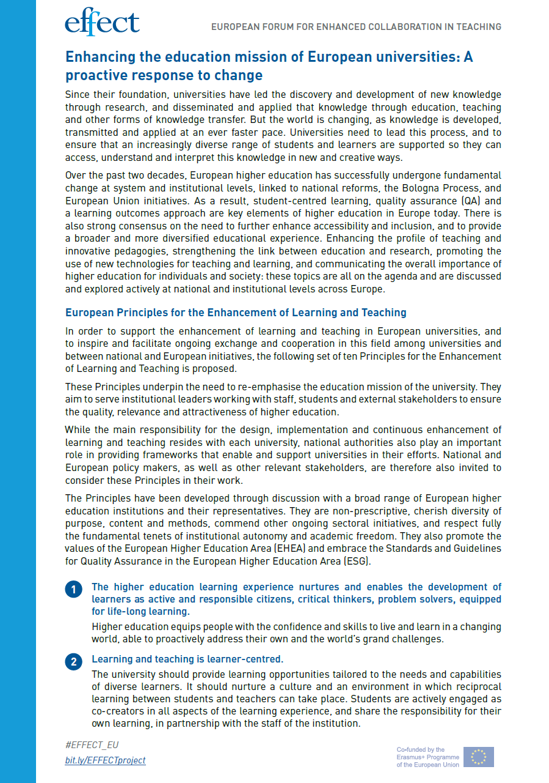
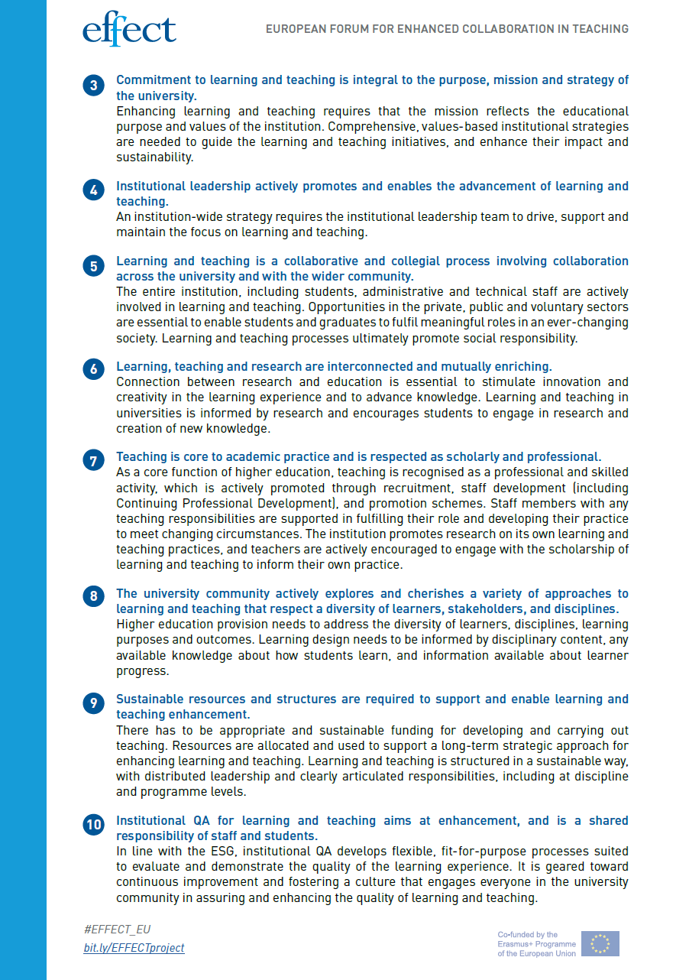
European Principles for Enhancement of L&T

Slide 6
Source: EUA 2018: 46.

Slide 7
The aim of the project DASCHE is:
to provide assistance to Higher Education Institutions as well as national and European policy makers in shaping social competences of students.

Slide 8
Partnership:
University of Bremen (Germany), Academic Information Centre (Latvia), Centre for Higher Education Studies (Czech Republic), University of Durham (United Kingdom), University of Twente (the Netherlands), SGH Warsaw School of Economic (Poland, leader).

Slide 9
Associated partners:

Slide 10
Case studies method of research
Selecting the HE institutions and their units/programmes for case studies
Desk research of strategic national and institutional documents
Field research - individual in-depth interviews (IDI) with senior management staff at the HEIs
Field research – focus group Interviews (FDI) with teachers and students
Consultations of findings and recommendations with external stakeholders (seminars, IDIs) – associated partners
Conclusions
Recommendations on institutional, national and European levels
Looking for examples of good practices: see the posters

Slide 11
COUNTRY | INSTITUTIONS
CZ | Charles University
 | West Bohemia University
 | University of Economy and Management, Prague
 | Medical College of Nursing
 | University of Ostrava
DE | University of Bremen
 | University of Konstanz
 | University of Cologne
 | Technical University of Dresden
LV | Riga Stradiņš University
 | School of Business and Finance
 | University of Latvia
 | Riga Technical University
 | Transport and Telecommunication Institute
NL | ArtEZ Institute of the Arts
 | Radboud University
 | University of Twente
PL | PWSZ in Elbląg
 | Collegium Medicum of the Jagiellonian University in Krakow
 | Lodz University of Technology
 | University of Social Sciences and Humanities
 | SGH – Warsaw School of Economics
UK | University A
 | University B
 | University C
 | University D

Slide 12
What are social competences?
Variety of meanings
Impact of EQF, key competences, legislation, tradition, need of students and society in general, etc.
Valuable but difficult for discussion
DASCHE definition:
... a one-size-for all approach is not beneficial and not recommended... Despite this variety of social competences characteristics, .... we can notice one relevant feature of the above mentioned approaches. All of them recognize social competences as an overall meta-competence, built over knowledge and skills, enriched by axiological reflection, enabling an independent and responsible application of knowledge and skills, aimed at common social good...

Slide 13
How do we shape social competences - „lessons learnt”
All or the most of the DASCHE project respondents as well as representatives of the associated partners stated that:
Shaping social competences of graduates is one of the crucial goals of higher education;
There is too less attention paid to what the social competences are and by mean of what didactic methods they are to be shaped; it is important to analyze and present the social impact of this neglection.
This situation should be changed starting with a debate on conceptualization of social competences on institutional and national levels; such debates were carried on in chosen countries only;
Higher education institutions are getting too less support from legislation and from decision makers of different levels to implement effective process of designing and implementing the social competences into teaching and learning process;
Only in chosen higher education institutions and countries the activities devoted directly and intentionally for shaping social competences were undertaken. More often it is understood as a side-effect of the teaching and learning process and left to the teachers’ personal engagement;
But teachers are not sufficiently prepared to integrate effectively social competences into study courses;
Achievement of social competences is not well recognized and evaluated by quality assurance internal systems and external agencies;
.......

Slide 14
DASCHE – the main recommendation
To create room to reflect on designing, developing and assessing social competences of students in higher education institutions.
To run a continuous debate among HEIs, HEIs Associations, Quality Assurance Agencies, Students Associations, employers, NGOs, national and European policy makers about social competences in higher education.
And long lists of detailed recommendations – see the DASCHE brochure.
All the DASCHE outputs you can find at:
www: dasche.eu
Erasmus+ platform

Slide 15
DASCHE question:
Next steps?
Particularly in time of the pandemic?

Slide 16
Thank you for your attention!
www. dasche.eu
echmie@sgh.waw.pl

