Slide 1
Assessment of transversal and social competences within formal vocational education and training – experiences of six European countries
Horacy Dębowski, Wojciech Stęchły, Alena Tomengova, Jakub Valovic, Kaja Reegard

Slide 2
Plan of the presentation:
Definitions & concepts
Solutions regarding formulation of learning outcomes
Development of TKC – outcomes of the country reports
Solution regarding assessment
Conclusions

Slide 3
Part I – Definitions & concepts

Slide 4
In the TRACK-VET project proposal we decided to use the term transversal key competences (TKC), which is defined as a subgroup of the 8 key competences defined in the Council Recommendation on Key Competences for Lifelong Learning (2018), namely:
- Personal, social and learning competence - Civic competences - Entrepreneurship competence - Cultural awareness and expression competence

Slide 5
Development of transversal key competences
Development of TKC is understood as the intentional process of forming competences.
This process might be defined in the curricula, programmes or other documents.
In many instances competences are being developed freely, sometimes unintentionally. We did not aim to investigate these aspects in detail, because of the systemic focus of the project

Slide 6
Assessment of transversal key competences
Assessment “means, methods and processes used to establish the extent to which a learner has in fact attained particular knowledge, skills and competence”.
In this sense assessment is similar concept to the concept of “examination”.
We adopted the approach and definition of “assessment” from the ECVET Recommendation 2009.

Slide 7
Formal initial and continuous VET system
We proposed to define formal initial and continuous VET, as systems that have some or all of the below characteristics:
based on core-curriculum or national qualification (standard);
lead to state recognised (and very often state examined and quality assured) qualifications;
be funded by the state (at least partially);
is not part of 1st or 2nd cycle in higher education.

Slide 8
Part II
The learning outcomes descriptions -
how are TKCs being modelled in educational documents?

Slide 9
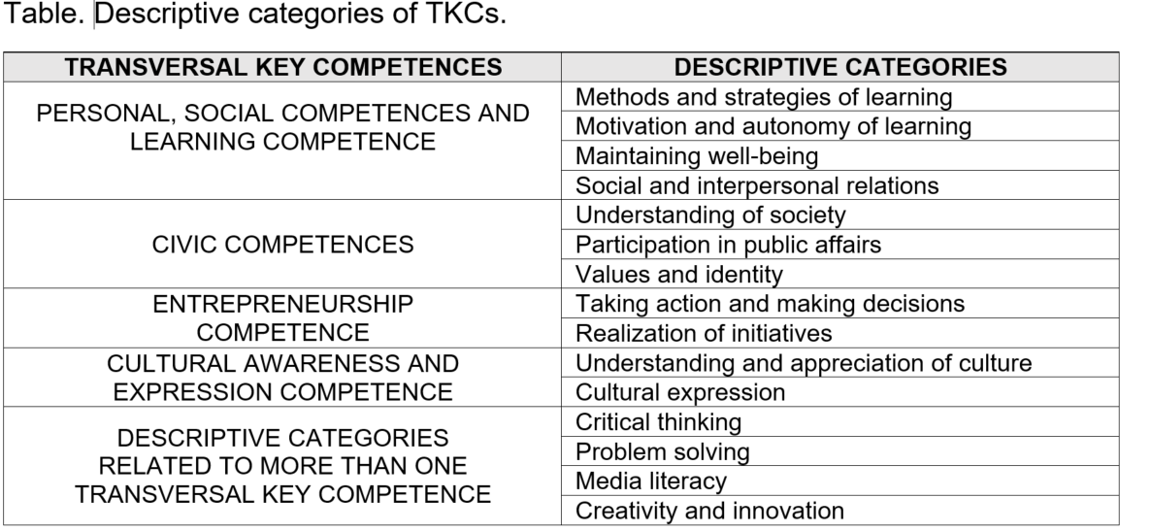

Slide 10
Research questions:
Where are TKCs to be found in educational documentation?
What is the scope of their representation?
How are they being described/formulated? Who is responsible for the description of TKCs in documentation?
Are NQF level descriptors taken into account when designing the descriptions/requirements?

Slide 11
Findings:
We identified different models of embedding TKCs in VET
Uneven distribution: some TKCs are much less frequently mentioned in documents
Descriptions are often vague and reduce TKCs to the knowledge domain
Mixed evidence of influence of qualifications frameworks on supporting TKCs development

Slide 12
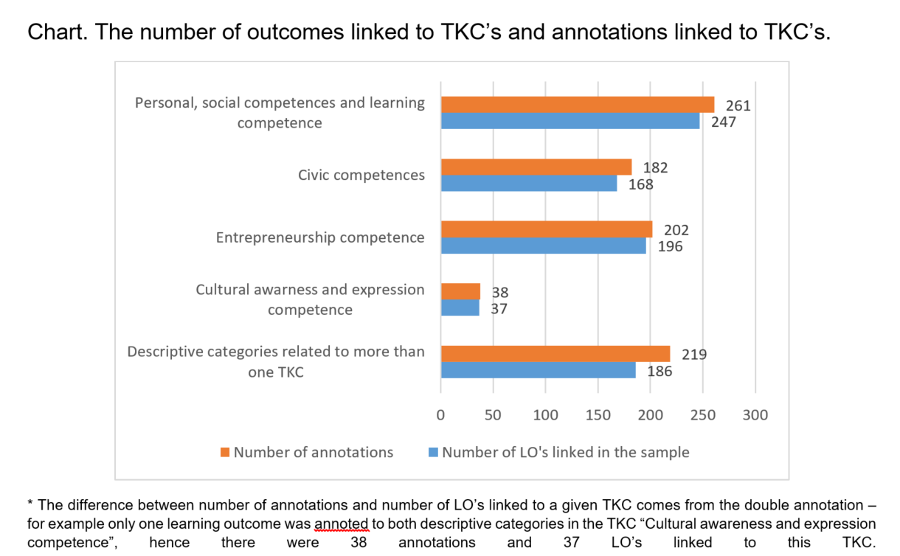
Outcomes of the quantitative analysis (1):

Slide 13
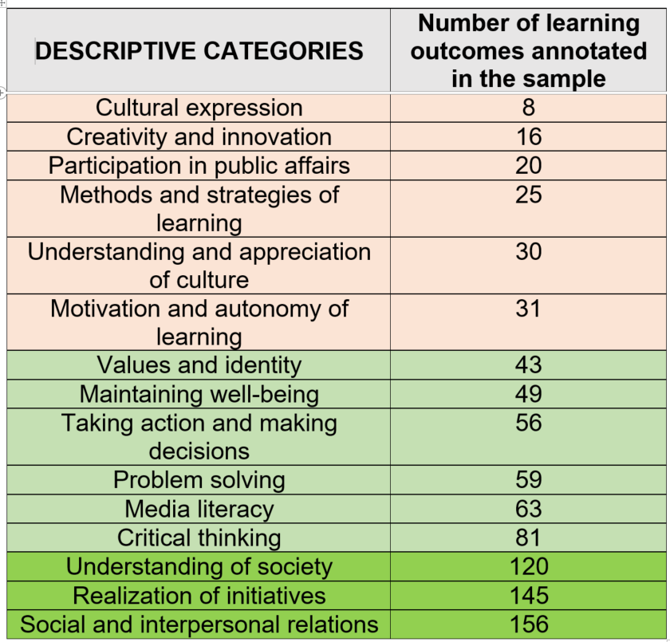
Outcomes of the quantitative analysis (2):

Slide 14
Models of formulation LO (1):
Model 1. The strong conceptual point of reference – example of BIST educational standards (Bildungstandards) in Austria

Slide 15
Models of formulation LO (2):
Model 2. The multilateral network of categories – example of France

Slide 16
Models of formulation LO (3):
Model 3. TKC’s unitised – example of Poland and Latvia

Slide 17
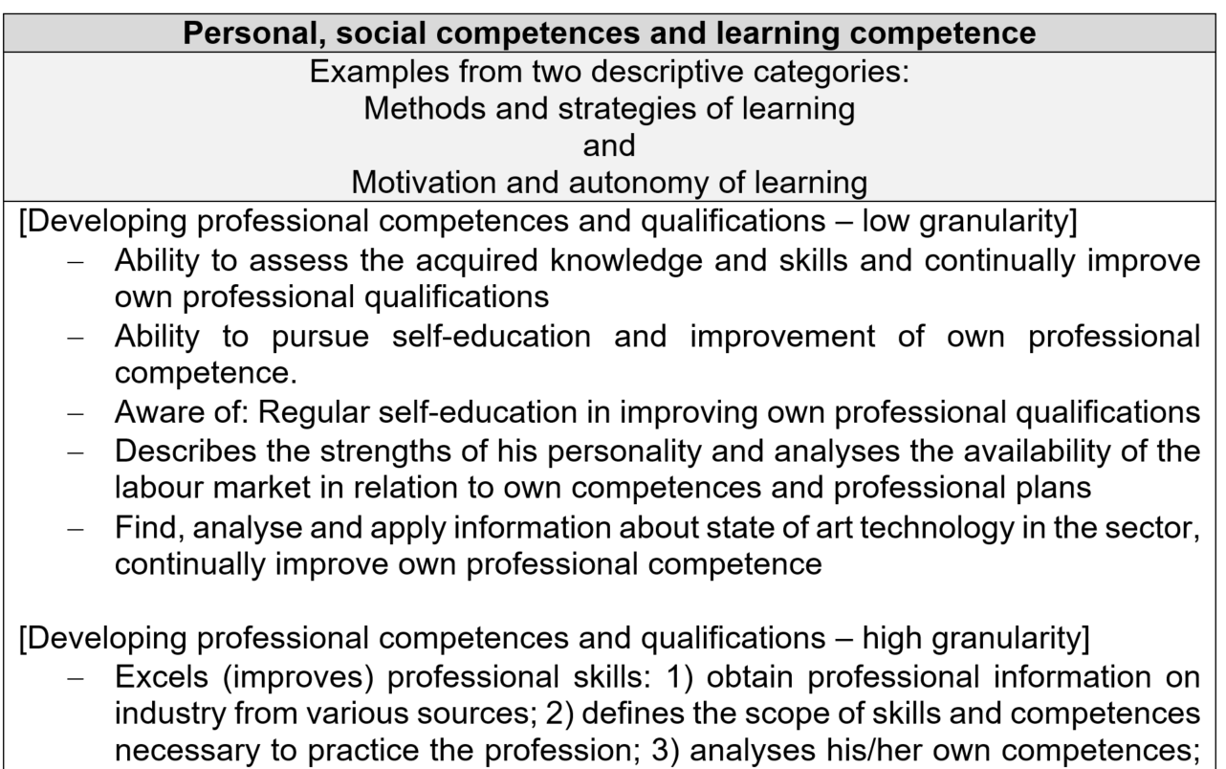
Examples of TKCs presented in the report:

Slide 18
Part III
Development of TKC – presentation of the main conclusions from the country reports

Slide 19
TKC development in IVET and CVET
Responsibility of teachers, trainers, tutors, co-workers
Places for competence development: schools, work-places in school settings or enterprises
TKC development is not possible if old fashion teaching methods and strategies are applied
Transmissive teaching does not allow the key competence development, especially TKC

Slide 20
Professional Development of Teachers, Trainers, Tutors (1)
Professionalism has been associated with pedagogical and subject knowledge, commitment to serving students´ needs, strong individual and collective identities and professional autonomy
Training and Education: training endeavours to impart knowledge, skills and attitudes and improve job performance in a direct way; education is to impart knowledge and develop cognitive abilities applicable to all important life-situations (Brundrett and Silcock 2002)

Slide 21
Professional Development of Teachers, Trainers, Tutors (2)
Continuing professional development:
retooling (ideas, knowledge and techniques learned can be immediately applied to the classroom),
remodelling (modifying existing practises to ensure that teachers are compliant with government change agendas),
revitalising (focus is upon teacher renewal, providing opportunities for teachers to reflect upon why they came into teaching in the first place, and examining beliefs and practises through professional development networks, or participation in practise-based enquiries;
reimagining (development of teacher´s “critical and transformative capacities”). Judyth Sachs (2011)

Slide 22
TKC are developed if:
the learning goals are clear,
the learning contents relevant,
the training includes practice with feedback, behavioural modelling and error-based examples,
the work environment is friendly and safe.

Slide 23
Strategies for competence development in IVET and CVET supported by active deep learning
situated learning in real- life work situations
project - based learning
creation of portfolio

Slide 24
Deep learning supports to acquire domain –specific knowledge and development of domain-specific skills. While deep learners acquire the skills in a concrete task, they build at the same time the competence to transfer these skills to another situation. (Nägele & Stalder 2017)

Slide 25
Situated learning has been defined as a learner executing tasks and solving problems in an environment which reveals the various intended uses of the knowledge. (Brown, 1989).
For situated learning to be effective it needs to be embedded in the authentic activities and social relations which comprise cultural practice. The learning activities which fail to access and engage in a culture of practice are less likely to be generative of effective learning outcomes.
This does not exclude instructional interludes to deepen an understanding of vocational activities (Billett,1994).

Slide 26
Project – based learning is a dynamic classroom approach in which students actively explore real-world problems and challenges and acquire a deeper knowledge (in-depth exploration of a topic, real-life experiences, give students voice and choice, share their work and develop communication, application of problem-solving, creativity and critical thinking development)

Slide 27
Key competence development – some resources
School Education Gateway – Publications, Tutorials,
Teaching Materials
Europe's online platform for school education
Available online:
https://www.schooleducationgateway.eu/en/pub/latest/news/key-competence-development.htm https://arpdcresources.ca/consortia/learning-through-competencies/
Competence learning guides

Slide 28
Part IV
Assessment of transversal key competence
How are TKCs assessed?

Slide 30
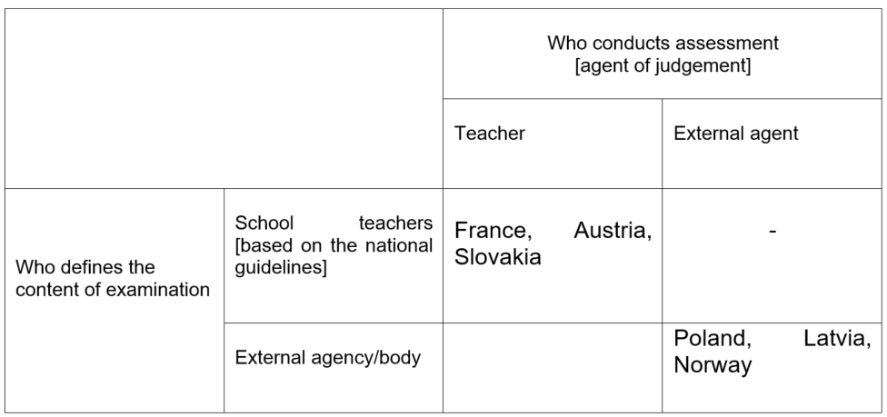

Slide 31
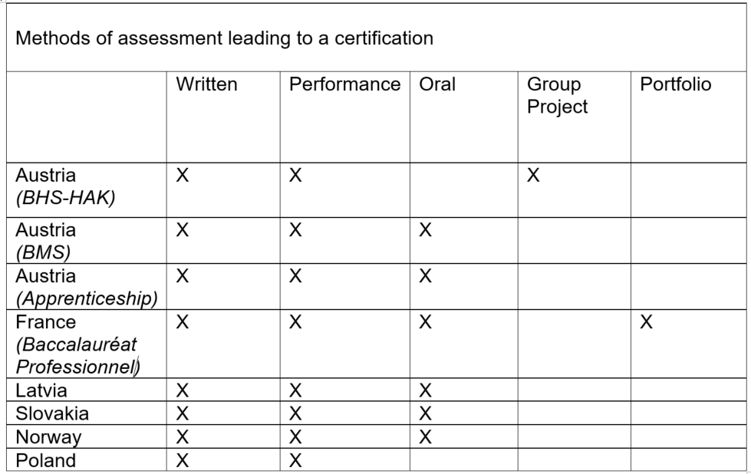

Slide 32
Transversal key competences are being assessed only to a very limited extend, mostly during continous assessment conducted by teachers. Assessment of TKCs are – apart from some cases – are almost non existent within the assessment leading to a certification
Continous assessment conducted while learning at school has mostly summative character. Summative assessment still is the dominant form of assessment in schools when it comes to the determination of grades

Slide 33
3. Identified good practices:
project based assessment introduced by Austria
portfolio method, including e-portfolio introduced by France
social project intiative developed by the Zwolnieni z teorii project in Poland

Slide 35
Part V
Main conclusions and recommendations
(based on interviews, analysis of documents, literature review)

Slide 36
1. Would descriptive categories related to competences defined in the Council of the EU adopted on key competences for lifelong learning (2018) be a useful platform in discussion between partners
Answer: yes
Comment: for the purpose of estabilishing a common understanding and preparing country reports TRACK-VET transversal key competences had to be operationalised

Slide 37
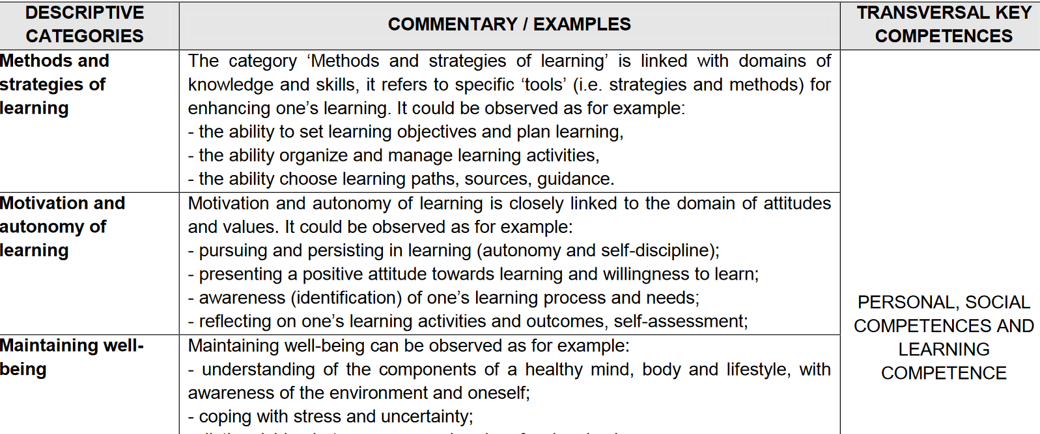

Slide 38
2. Is differentiation between professional / task specific skills and transversal (or social, or any other subcategory) competences needed.
Answer: yes
Comments: differentiation between professional / task specific skills and transversal (or social, or any other sub category) competences creates a false dichotomy - it is an analytical concept used to describe similar aspects of human capabilities observed in varying situations.
As it turns out not using these „artificial” categories may in some cases (e.g. time limitation and assessment focus on specific skills) lead to incomplete development of the relevant competencies. This is especially relevant for countries in which the different concepts of competence are less used / developed.
Notes:
Tam gdzie Winterton i inni tacy, nie pisali o kompetencjach, te pojęcia nie wpływały na ludzkie myślenie, a w rezultacie łatwiej było zapomnieć o całościowym wymiarze kompetencji – mogło dochodzić do redukcji do specific skills.

Slide 39
3. Should TKC’s (including social competences) be developed within formal vocational education?
Answer: yes. Formal VET should be contributing more strongly to challenges appearing currently in European socities (immigration, radicalisation of views, developments on the labour markets).
Comment: this is quite well reflected in the strategic documents and in VET core curricula

Slide 40
Presence of TKC in the strategic documents and core curricula
 | Personal, social competences and learning competence | Civic competences | Entrepreneurship competence | Cultural awareness and expression competence
Austria | X | X | X | X
France | X | X | X | X
Latvia | X | X | X | X
Norway | X | X | X | X
Poland | X | X | X | X
Slovakia | X | X | X | X

Slide 41
Austria fragments of the VET curricula:
Students have the competence to:
deal with religions, cultures and ideologies, to take part in cultural life and to show understanding and respect for others
to deal with the essential question, with ethical and moral values as well as with the religious dimensions of life
to effectuate lifelong learning as immanent part of life-planning and career management
Austrian country report

Slide 42
Latvia fragments of the VET strategic documents:
“to ensure a student with the knowledge and skills necessary for personal growth and development, civil participation, employment, social integration and continuation of education”; “to promote the improvement of a student as a mentally, emotionally and physically developed personality and to develop habits of healthy lifestyle”; “to promote a socially active attitude of the student, retaining and developing his or her language, ethnical and cultural particularity, as well as to improve understanding regarding the basic principles of human rights included in the Constitution of the Republic of Latvia and other legal acts “ to develop the student’s ability to learn and improve independently, to motivate him or her for lifelong learning and an informed career”.
(Section 2, Regulations Regarding the State General Secondary Education Standard, Subject Standards and Sample Education programs, Cabinet Regulations No 281, 21.05.2013)
Latvian country report

Slide 43
Reservation:
the programme documents do not provide a representation of school reality
realization of the policy-makers vision is formally expected of school principals and teachers, however the vision may be interpreted and implemented in different ways – this is especially relevant for transversal key competences

Slide 44
4. Should TKC be asssessed within formal VET? (1)
With regards to formative assessment – answer is yes
With regards to assessment for licensure - no conclusive answer
Based on the analysis of the six countries experiences – we do not know, if this is desirable or even possible
Further analysis is needed – in each case weighting the risks of reductionism („dumbing down”), the need for elastic approach for groups and individuals and the benefits of using summative assessment and gathering experiences (experimenting) would be required.

Slide 45
4. Should TKC be asssessed within formal VET? (2)
There is no formal or standalone assessment of TKCs in any of the participating countries.
Continuous assessment is in TRACK-VET project countries largely left on the discretion of teachers
But leaving aside TKC outside assessment for licensure is considered in some countries as a danger.

Slide 46
4. Should TKC be asssessed within formal VET? (3)
Assessment of TKC does not need to be incorporated into the decision what mark is assigned to the student, but maybe an oral comment on them would be of some value – shifting some of the attention towards TKCs as integral part of professional skills and giving student a feedback?

Slide 47
Norway country report:
„In extension of this discussion we were presented with what may seem to be a dilemma: in order for TKC to be acknowledged as important in practice, it must be measurable, but if TKC is laid down in curricula in ways that make it measurable, it loses its importance as TKC. This means that it requires a reduction of TKC – a type of operationalization – which appears to stand in contrast to the idea of TKC”

Slide 48
France country report:
Generally speaking, the inspectors perceive TKCs as attitudes or behaviours which are not necessarily very objectifiable and therefore difficult to assess, except perhaps in the workplace. From this perspective, for some of them, periods of workplace training would be an appropriate situation for assessing these types of competence.

Slide 49
5. Should TKC assessed within assessment for licensure, even to limited extent?
No conclusive answer
Comment: Interviewed experts within countries had different views whether assessment in limited scope, should be done or not.
Examples of what limited extent might stand for – „just knowledge”, „skills not attitudes”, „observable behaviours in group work”.

Slide 50
6. The role of employers
Consensus within all country experts: employers should be involved in development of TKC
No workplace socialisation without employers involvement. But the role of employers is much wider.
According to some expert employers are better equipped to assess TKCs.

Slide 51
France country report:
Anyway, there are some competences where the business is the best place because it’s the most specific, maybe all the transversal competences where in a business people are much more vigilant, perhaps as to what is going on in collaborative and team projects and interactions between the various trades. I still think that the business world is perhaps more logical for developing those competences” General inspector for industrial sciences and technology

Slide 52
7. The problem of basic/foundation skills
In a some countries (e.g. France, Slovakia, Poland) interviewees said that at the secondary education level, the requirements prescribed in curricula are often assuming a previous level of fundamental skills that learners do not have.
The PISA results consistently show a relative deficit of VET learners in mathematics, science and reading. A correlation of the level of these fundamental competences and levels of TKC’s achievement would not be surprising at all, since they might both be determined by socio-economic status of parents

Slide 53
7. Significant number of LO related to TKC are in general part of the core curricula which might not be part of the assessment for VET certificate

Slide 54
8. Learning competence the least represented in the curricula:
The fact that the learning competence is among the least represented in the sample is alarming.
The following questions arise in this context:
- Do VET students have autonomy of learning and are being supported or encouraged in developing methods, strategies and motivation for learning?
- Is the learning competence being transmitted informally and therefore does not need to be listed in the curriculum?
- Do we learn how to learn enough?

Slide 55
Recommended actions for the policy level in VET:
Extending assessment for licensure/qualification methods beyond examinations (bringing well known methods to mainstream: portfolios, projects, thesis as integral part of the grade)
Support to teachers (training and new qualifications, materials, guidelines, examples)
Developing and testing learning outcomes, assessment criteria and procedures (linked with guidance for learners and teachers)

Slide 56
Actions for the policy level in VET:
Enhancing involvement of employers
International mobilities (e.g. Erasmus+), domestic and international competitions (e.g. Worldskills)
Putting stronger focus on foundation skills (literacy, language)
Embracing a holistic perspective – developing TKC’s in meaningful contexts, not as a standalone competence

Slide 57
Actions for the policy level in VET:
more synergies with the higher education sector in terms of practice sharing
HE recrutation strategies might provide additional incentives (e.g. if univeristy requires conducting social project in its entry exams)

Slide 58
Thank you for your attention
We encourage to visit TRACK-VET project web site where materials, reports, presentations are being publihed
http://www.track-vet.eu/

Slide 59
TRACK-VET project is funded by the Erasmus+ Programme, KA2, VET

