Slide 1
Assessment of transversal and social competences within formal vocational education and training – experiences of six European countries. Preliminary results of the TRACK-VET project
Horacy Dębowski, Wojciech Stęchły
SGH Warsaw School of Economics

Slide 2
TRACK-VET Partnership:
1. Fafo, Institute for Labour and Social Research (Norway)
2. Céreq, French Centre for Research on Qualifications (France)
3. Oeibf, Austrian Institute for Research on Vocational Training (Austria)
4. VISC, National Centre for Education (Latvia)
5. SGH Warsaw School of Economics (Poland)
6. NUCEM, National Institute for Certified Educational Measurements (Slovakia)
7. UMB, Matej Bel University Banská Bystrica (Slovakia)

Slide 3
Aims of the TRACK- VET project
to support policy design in the area of development and assessment of transversal key competences in VET

Slide 4
Main rationale of the project:
Although key competences including TKC are high on a policy agenda, still lots of issues related to development and especially assessment of TKC remain unsolved

Slide 5
How did we want to achieve the aims of the project?
interviews with more than 150 experts from six countries and desk research
preparing country reports of 6 European countries and cross-reviews
preparing synthesis of solutions implemented and used in European countries related to development, assessment, validation of TKC

Slide 6
In the TRACK-VET project proposal we decided to use the term transversal key competences (TKC), which is defined as a subgroup of the 8 key competences defined in the Council Recommendation on Key Competences for Lifelong Learning (2018), namely:
- Personal, social and learning competence - Civic competences - Entrepreneurship competence - Cultural awareness and expression competence

Slide 7
Relation with the DASCHE project (1):
The competences chosen for the TRACK-VET project can be seen as the same field of competence as DASCHE project, but relate to different level (of competences) and application contexts.
TRACK-VET: mostly professional situations linked to mid-level vocational tasks and typical life situations
DASCHE: lifewide social participation, high level social awareness and professional situations linked to a different set of professions
Notes:
Luźno dalej: anyway, we talk about the steps / levels in competence development that preceed those seen in DASCHE. This is especially relevant in relation to the next comment.

Slide 8
Relation with the DASCHE project (2):
Within the TRACK-VET project we are especially interested in summative assessment, leading to validation and certification
Why bother with summative assessment of TKC’s? Because of the VNIL trend in VET in Europe.
For learners in pathways with less analog and organized education attaining social competences may pose additional difficulties. Should the credentials / qualifications attained via VNIL be of equal value, an approach for tackling assessments linked to aspects other than knowledge and specific skills is needed.
*VNIL – Validation of non-formal and informal learning
Notes:
Luźno dalej: anyway, we talk about the steps / levels in competence development that preceed those seen in DASCHE. This is especially relevant in relation to the next comment.

Slide 9
Development of transversal key competences
Development of TKC is understood as the intentional process of forming competences.
This process might be defined in the curricula, programmes or other documents.
In many instances VET systems develop competences “unintentionally” we do not aim to investigate these aspects in detail, because of the systemic focus of the project

Slide 10
Assessment of transversal key competences
We adopted the approach and definition of “assessment” from the ECVET Recommendation 2009.
Assessment “means, methods and processes used to establish the extent to which a learner has in fact attained particular knowledge, skills and competence”.
In this sense assessment is similar concept to the concept of “examination”.

Slide 11
Formal initial and continuous VET system
We proposed to define formal initial and continuous VET, as systems that have some or all of the below characteristics:
- based on core-curriculum or national qualification (standard);
- lead to state recognised (and very often state examined and quality assured) qualifications;
- be funded by the state (at least partially);
- is not part of 1st or 2nd cycle in higher education.

Slide 12
Main conclusions based on the research questions (based on 150 interviews, analysis of documents, literature review)

Slide 13
1. Would descriptive categories related to competences defined in the Council of the EU adopted on key competences for lifelong learning (2018) be a useful platform in discussion between partners
Answer: yes
Comment: for the purpose of estabilishing a common understanding and preparing country reports TRACK-VET transversal key competences had to be operationalised

Slide 14
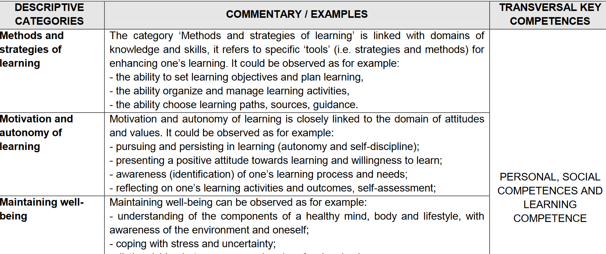

Slide 15
2. Is differentiation between professional / task specific skills and transversal (or social, or any other subcategory) competences needed.
Answer: yes
Comments: differentiation between professional / task specific skills and transversal (or social, or any other sub category) competences creates a false dichotomy - it is an analytical concept used to describe similar aspects of human capabilities observed in varying situations.
As it turns out not using these artificial categories may in some cases (e.g. time limitation and assessment focus on specific skills) lead to incomplete development of the relevant competencies. This is especially relevant for countries in which the different concepts of competence are less used / developed.
Notes:
Tam gdzie Winterton i inni tacy, nie pisali o kompetencjach, te pojęcia nie wpływały na ludzkie myślenie, a w rezultacie łatwiej było zapomnieć o całościowym wymiarze kompetencji – mogło dochodzić do redukcji do specific skills.

Slide 16
3. Should TKC’s (including social competences) be developed within formal vocational education?
Answer: yes. Formal VET should be contributing more strongly to challenges appearing currently in European socities (immigration, radicalisation of views, developments on the labour markets).
Comment: this is quite well reflected in the strategic documents and in VET core curricula

Slide 17
Presence of TKC in the strategic documents and core curricula
 | Personal, social competences and learning competence | Civic competences | Entrepreneurship competence | Cultural awareness and expression competence
Austria | X | X | X | X
France | X | X | X | X
Latvia | X | X | X | X
Norway | X | X | X | X
Poland | X | X | X | X
Slovakia | X | X | X | X

Slide 18
Austria fragments of the VET curricula:
Students have the competence to:
deal with religions, cultures and ideologies, to take part in cultural life and to show understanding and respect for others
to deal with the essential question, with ethical and moral values as well as with the religious dimensions of life
to effectuate lifelong learning as immanent part of life-planning and career management
Austrian country report

Slide 19
Latvia fragments of the VET strategic documents:
“to ensure a student with the knowledge and skills necessary for personal growth and development, civil participation, employment, social integration and continuation of education”; “to promote the improvement of a student as a mentally, emotionally and physically developed personality and to develop habits of healthy lifestyle”; “to promote a socially active attitude of the student, retaining and developing his or her language, ethnical and cultural particularity, as well as to improve understanding regarding the basic principles of human rights included in the Constitution of the Republic of Latvia and other legal acts “ to develop the student’s ability to learn and improve independently, to motivate him or her for lifelong learning and an informed career”.
(Section 2, Regulations Regarding the State General Secondary Education Standard, Subject Standards and Sample Education programs, Cabinet Regulations No 281, 21.05.2013)
Latvian country report

Slide 20
Reservation (1):
the programme documents do not provide a representation of school reality
realization of the policy-makers vision is formally expected of school principals and teachers, however the vision may be interpreted and implemented in different ways – this is especially relevant for transversal key competences
Notes:
Ten drugim punkt można powiązać ze wspomnianymi wcześniej pojęciami kompetencji. Jeśli wskazane w programach pojęcia czy cele nie są dobrze osadzone (przechowywane, dające się rozpakować dzięki) w praktyce językowej / dydaktycznej (np. każdy wie, że nie można zapomnieć o savoir etre, a fachkompetenze, albo trzeba myśleć holitycznie o kształceniu zawodowym) – to takie zapisy mają tendencję do pozostawania pustymi.

Slide 21
4. Should TKC be asssessed within formal VET?
With regards to formative assessment – answer is yes
With regards to summative assessment - no conclusive answer
Based on the analysis of the six countries experiences – we do not know, if this is desirable or even possible.
Further analysis is needed – in each case weighting the risks of reductionism („dumbing down”), the need for elastic approach for groups and individuals and the benefits of using summative assessment and gathering experiences (experimenting) would be required.

Slide 22
4. Should TKC be asssessed within formal VET? (2)
There is no formal or standalone assessment of TKCs in any of the participating countries. Continuous assessment is in project countries largely left on the discretion of teachers
But leaving aside TKC outside summative assessment is considered in some countries as a danger.

Slide 23
4. Should TKC be asssessed within formal VET? (3)
Assessment of TKC does not need to be incorporated into the decision what mark is assigned to the student, but maybe an oral comment on them would be of some value – shifting some of the attention towards TKCs as integral part of professional skills and giving student a feedback?

Slide 24
Norway country report:
„In extension of this discussion we were presented with what may seem to be a dilemma: in order for TKC to be acknowledged as important in practice, it must be measurable, but if TKC is laid down in curricula in ways that make it measurable, it loses its importance as TKC. This means that it requires a reduction of TKC – a type of operationalization – which appears to stand in contrast to the idea of TKC”

Slide 25
France country report:
Generally speaking, the inspectors perceive TKCs as attitudes or behaviours which are not necessarily very objectifiable and therefore difficult to assess, except perhaps in the workplace. From this perspective, for some of them, periods of workplace training would be an appropriate situation for assessing these types of competence.

Slide 26
5. Should TKC be assessed, even to limited extent?
No conclusive answer
Comment: Interviewed experts within countries had different views whether assessment in limited scope, should be done or not.
Examples of what limited extent might stand for – „just knowledge”, „skills not attitudes”, „observable behaviours in group work”.

Slide 27
6. The role of employers
Consensus within all country experts: employers should be involved in development of TKC
No workplace socialisation without employers involvement. But the role of employers is much wider.

Slide 28
France country report:
Anyway, there are some competences where the business is the best place because it’s the most specific, maybe all the transversal competences where in a business people are much more vigilant, perhaps as to what is going on in collaborative and team projects and interactions between the various trades. I still think that the business world is perhaps more logical for developing those competences” General inspector for industrial sciences and technology

Slide 29
Recommended actions for the policy level in VET:
Extending summative methods beyond examinations (bringing well known methods to mainstream: portfolios, projects, thesis as integral part of the grade)
Support to teachers (training and new qualifications, materials, guidelines, examples)
Developing and testing learning outcomes, assessment criteria and procedures (linked with guidance for learners and teachers)

Slide 30
Actions for the policy level in VET:
Enhancing involvement of employers
International mobilities (e.g. Erasmus+), domestic and international competitions (e.g. Worldskills)
Putting stronger focus on foundation skills (literacy, language)
Embracing a holistic perspective – developing TKC’s in meaningful contexts, not as a standalone competence

Slide 31
Thank you for your attention
Horacy Dębowski, Wojciech Stechly
hdebowski@gmail.com wojciech.stechly@gmail.com

Slide 32
TRACK-VET project is funded by the Erasmus+ Programme, KA2, VET
(September 2017 – August 2020)

Slide 33
TRACK-VET project conference 23rd of April 2020 in Warsaw

