Slide 1
TRACK-VET project – setting the scene for the conference
Horacy Dębowski, Wojciech Stęchły
24.11.2020

Slide 2
Technical issues:
Any problems during the conference might be reported via:
- MS Teams Chat or
- email: kmatus@sgh.waw.pl

Slide 3
Questions and Answers:
Questions might be posed via MS Teams chat
If some of the questions could not be answered during the meeting, they will be answered by the project team after the conference

Slide 4
TRACK-VET Partnership:
1. Fafo, Institute for Labour and Social Research (Norway)
2. Céreq, French Centre for Research on Qualifications (France)
3. Oeibf, Austrian Institute for Research on Vocational Training (Austria)
4. VISC, National Centre for Education (Latvia)
5. SGH Warsaw School of Economics (Poland)
6. NUCEM, National Institute for Certified Educational Measurements (Slovakia)
7. UMB, Matej Bel University Banská Bystrica (Slovakia)

Slide 5


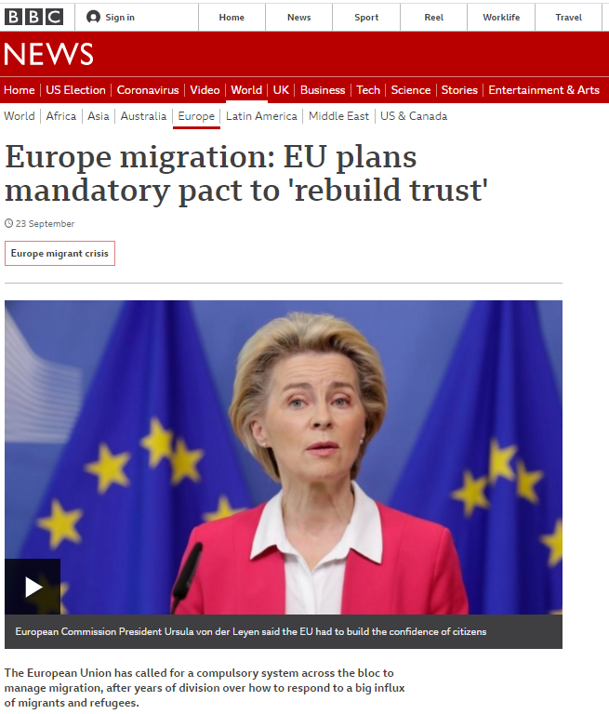
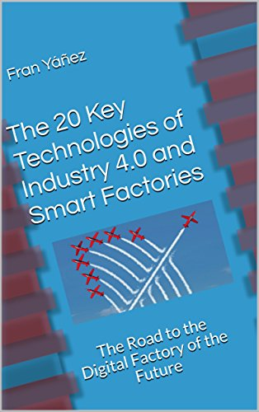



Slide 6
We need systemic solutions to support development of transversal key competences
Social Competence
Entrepreneurship
Competence
Cultural Awarness
Critical Thinking
Learning competence
Problem Solving
Civic Competence
Media Literacy

Slide 7
Main rationale of the project:
Although key competences (including TKC's) are high on a policy agenda,
systemic solutions for development and assessment of TKC's remain to a large extent an ’uncharted territiory’.
We need to learn how our systems can effectively support development of:
- civic competence in times of social turbulence
- learning competence in the era of accelerating change
- cultural awarness and literacy in the age of migrations and mobility
- social and personal competence in times of alienation and polarization
- …

Slide 8
How did we intend to achieve the aims of the project?
preparing country reports of 6 European countries in which development and assessment practices are described according to a common strucutre;
interviews with more than 150 experts from six countries and desk research
preparing synthesis of solutions implemented and used in European countries related to development, assessment, validation of TKC's. Describing practices, identifying model solutions, formulating recommendations

Slide 9
We decided to use the term transversal key competences (TKC's), which is defined as a subgroup of the 8 key competences defined in the Council Recommendation on Key Competences for Lifelong Learning (2018), namely:
- Personal, social and learning competence
- Civic competences
- Entrepreneurship competence
- Cultural awareness and expression competence

Slide 10
The transversal key competences (TKC's) are wide and fuzzy concepts.
To analyze their use, discuss and compare them, we analyzed the groups of meanings that these carry and developed a common framework of understanding – we called these the descriptive categories of TKC’s.
DESCRIPTIVE CATEGORIES | TRANSVERSAL KEY COMPETENCES
Methods and strategies of learning | PERSONAL, SOCIAL COMPETENCES AND LEARNING COMPETENCE
Motivation and autonomy of learning
Maintaining well-being
Social and interpersonal relations
Understanding of society | CIVIC COMPETENCES
Participation in public affairs
Values and identity
Taking action and making decisions | ENTREPRENEUR-SHIP COMPETENCE
Realization of initiatives
DESCRIPTIVE CATEGORIES | TRANSVERSAL KEY COMPETENCES
Understanding and appreciation of culture | CULTURAL AWARENESS AND EXPRESSION COMPETENCE
Cultural expression
Critical thinking | DESCRIPTIVE CATEGORIES RELATED TO MORE THAN ONE TKC
Problem solving
Media literacy
Creativity and innovation

Slide 11
Institutions role in developing TKC’s:
Formal institutions – such as educational documentation hierarchy and content (e.g. core-curriculum → curriculum → teaching/learning contents and activities)
Informal institutions relate to normative, cognitive or procedural aspects affecting or regulating our behaviour. And these are of key relevance for the TKC's formulation, use and interpretation:
  ’teaching for examinations’ or ’learning for tests’
  concepts of competence
  acceptance for overusing transmissive teaching practices (e.g. lecture)

Slide 12
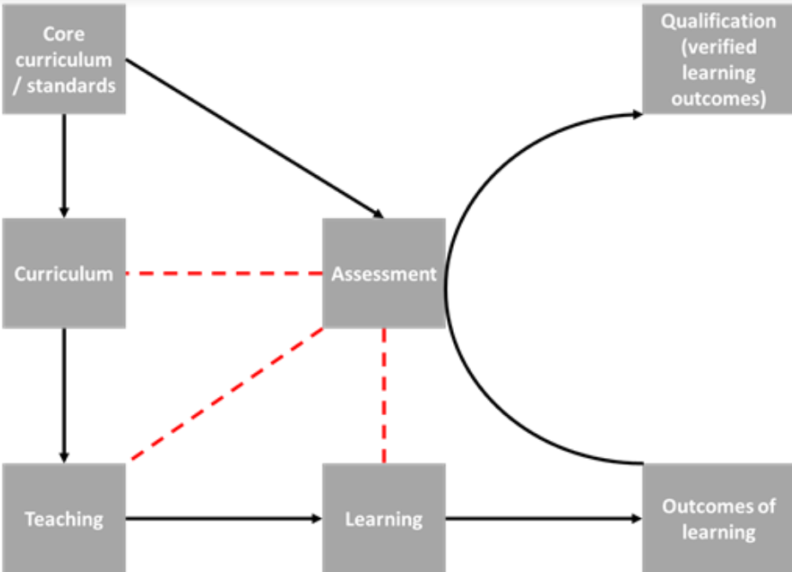
Coordination mechanisms in labour market (e.g. market, regulations, cooperative)
Trust and cooperation between companies and education sector
Normative institutions:
Equality and acceptance of assessments of some competences (e.g. personal, social, cultural)
Cognitive institutions: Translating to practice e.g. common concepts of competence
Procedural institution: Teaching and learning for assessment

Slide 13
DEVELOPMENT OF COMPETENCES WITHIN SCHOOL PRACTICE:
- TEACHING
- WORK BASED LEARNING/ APPRENTICESHIP
- SUMMATIVE ASSESSMENT
- FORMATIVE ASSESSMENT
- PLENTY OF OTHER ACTIVITIES
ASSESSMENT FOR LICENSURE/QUALIFICATION:
- TAKES INTO CONSIDERATION GRADES/ACHIEVEMENTS OF THE SCHOOL PRACTICE
OR:
- IS ORGANISED AS FINAL EXAMINATION LEADING TO LICENCSE/QUALIFICATION
(Grades acquired during learning at school are not taken into consideration)
?
GRADES,
SEMESTRAL GRADES
OTHER ACHIEVEMENTS
ACTIVITES AT THE BORDERS OF SCHOOL PRACTICE:
- MOBILITY PROJECTS, SOCIAL PROJECTS
- SKILLS COMPETETITIONS,
- PLENTY OF OTHER ACTIVITIES
Link

Slide 14
Assessment
Formative
(part of E&T)
Summative
(part of E&T)
Summative
(external)
Grades, Semestral Grades, Achievments, Badges, Documentation….
License or Qualification
?

Slide 15
Questions to our guest speakers:
How to promote development of TKC's?
What methods, solutions might be implemented?
What are good practices?
Should TKC's be included within assessment for licensure?
Can we expect sufficient development of TKC's if they are not included in the assessment for licensure?

Slide 16
TRACK-VET project is funded by the Erasmus+ Programme, KA2, VET

