Slide 1
Getting to Know Your Classmate
Main messages regarding development and assessment of transversal key competences
Aina Špaca / National Centre for Education
Developing, assessing and validating transversal key competences in the formal initial and continuing vocational education and training
- the experiences and solutions of 6 European countries
Online conference November 24th 2020

Slide 2
Among NCE main functions:
Main implementer of currently ongoing national reforms in VET (updated standards, modular programmes, learning outcomes-based VET, CPD of teachers/tutors, Work-based learning etc.)
Coordination of the development of national VET curriculum in cooperation with employer organisations.
Development of centralized VQE content and assessment criteria, which is exactly the same in all VET schools conducting examinations in a given profession.

Slide 3
The content and assessment of VET in Latvia is regulated by:
Vocational Education Law
National Vocational Education Standard
Sectoral Qualifications Framework
Profession (Occupational) Standards (~470)
Vocational Education Programmes

Slide 4
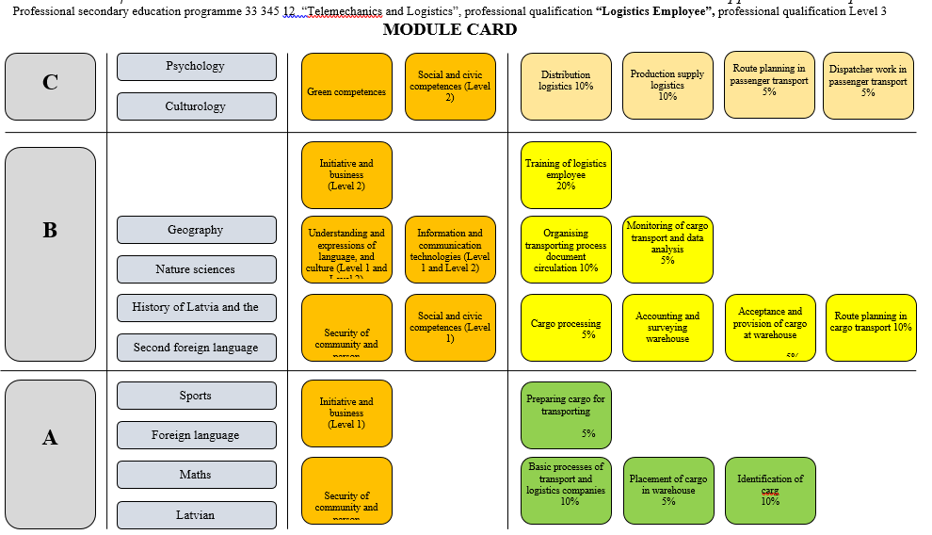
MODULE CARD (LOGISTICS EMPLOEE)

Slide 5
Transversal key competences in VET
LLL Modules (in B or C part):
Social and civic competences
Initiative and enterpreneurship
Safety of society and person
Language, cultural awarness and expression
Green skills
Information and communication technologies

Slide 6
Assessment and validation of TKC
SECTORAL QUALIFICATIONS FRAMEWORK
PROFESSION
STANDARDS
VOCATIONAL
QUALIFICATION
EXAMINATIONS
incl.centralized vocational qualification exam
VOCATION
EDUCATION
PROGRAMMES

Slide 7
Some Recommendations
More research is needed in VET regarding the implementation of programmes, assessment and validation of obtained qualifications.
TKC assessment should be included in the centralized professional qualification examination by the responsible authority.
Practical tools should be developed and offered for VET institutions to monitor TKC (content, assessment, outcomes and challenges) in specific stages of the education acquisition process.
The role and presence of formative assessment of TKC needs to be increased in the teaching/learning process.

Slide 8
National Centre of Education www.visc.gov.lv Aina Špaca
Thank you for your attention!

